Slide 1

Object Oriented Programming using Java

Slide 2
Outline
Data Type
Variable
Variable Name
Operators
Precedence of Operators
Examples of Operators

Slide 3
Data Type
S
There are mainly two types of data type:
Primitive: Byte, short, int, long, float, double, boolean
and char.
Non-primitive: String, arrays and classes

Slide 4
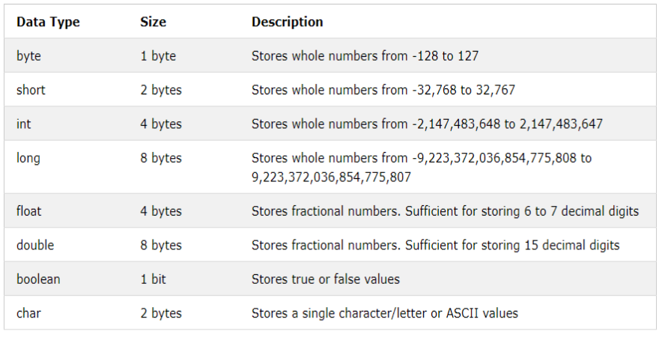
Data Type (Cont.)
S

Slide 5
Variable
S
A variables can be considered as a name given to the location in memory where values are stored.\
<datatype> <variable_name>
Can the value of variable be changed?
Yes

Slide 6
Variable Name
Use only the characters ‘a’ through ‘z’, ‘A’ through ‘Z, ‘0’
through ‘9’, character ‘_’, and character ‘$’.
A name can’t contain space character.
Do not start with a digit. Variable name can be of any length.
Case sensitive.
A name can not be a reserved word (A reserved word is a
word which has a predefined meaning in Java. Example: int,
double, true, etc.).

Slide 7
Variable Name (Cont…)
Can you answer that whether the below lines are correct or
not?
int good-bye;
int shrift = 0;
char thisMustBeTooLong;
int bubble = 0, toil = 9, trouble = 8
int 8ball;
int double;

Slide 8
Variable Name (Cont…)
Answers of the last slide:
int good-bye; //bad variable name
int shrift = 0; //OK
char thisMustBeTooLong; //OK in syntax //but poor choice in variable name
int bubble = 0, toil = 9, trouble = 8 // “;” missing at the end
int 8ball; //can’t start with a digit
int double; //double is a reserve word

Slide 9
Operators
S
There are many operators in Java::
Unary operators
Arithmetic operators
Relational operators
Bitwise operators
Logical operators
Assignment operators
Ternary operators

Slide 10
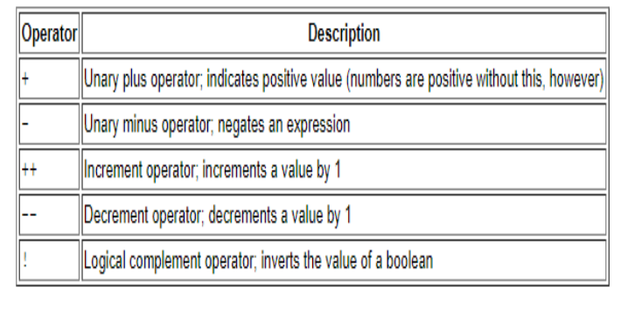
Operators (Cont.…)
S
Unary operators:

Slide 11
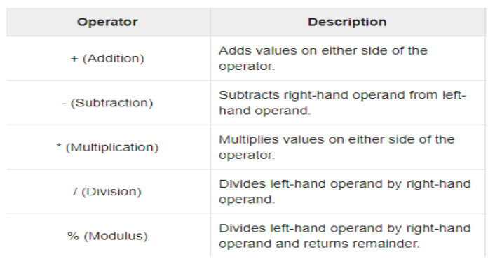
Operators (Cont.…)
S
Arithmetic operators:

Slide 12
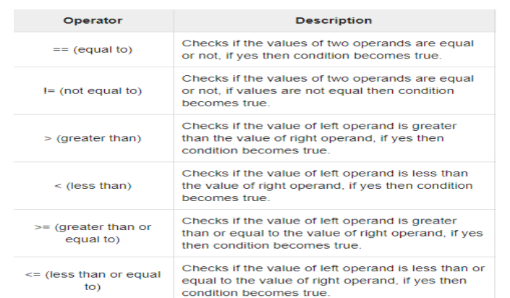
Operators (Cont.…)
S
Relational operators:

Slide 13
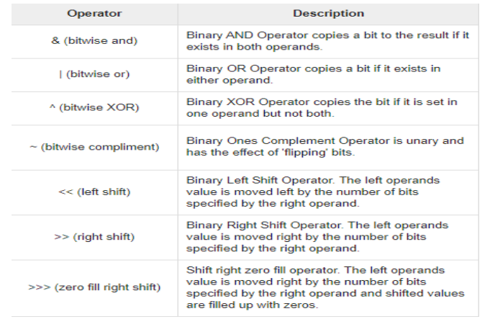
Operators (Cont.…)
S
Bitwise operators:

Slide 14
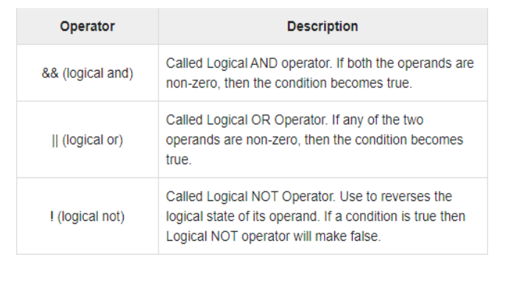
Operators (Cont.…)
S
Logical operators:

Slide 15
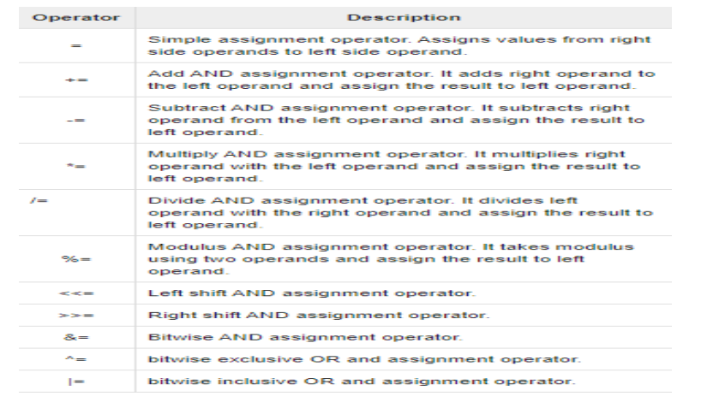
Operators (Cont.…)
S
Assignment operators:

Slide 16
Operators (Cont.…)
S
Ternary operators:
Conditional Operator ( ? : )

Slide 17
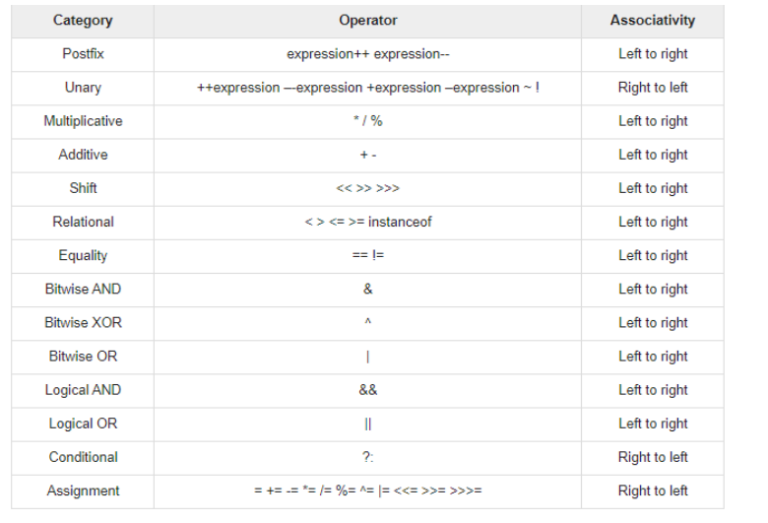
Precedence of the Operators
S

Slide 18
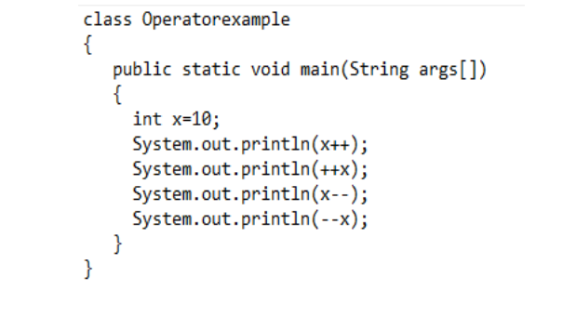
Examples of Operators
S

Slide 19
Examples of Operators
S
Output:
❖10
❖12
❖12
❖10

Slide 20
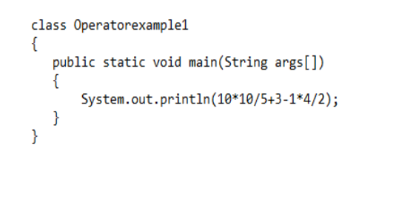
S
Examples of Operators (Cont.…)

Slide 21
Examples of Operators (Cont.…)
S
Output:
❖21

Slide 22
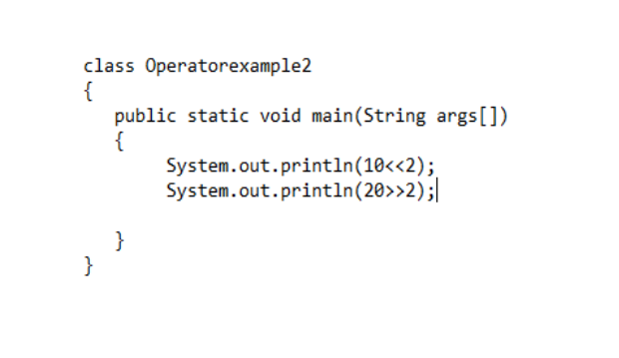
Examples of Operators (Cont.…)
S

Slide 23
Examples of Operators (Cont.…)
S
Output:
❖40
❖5

Slide 24
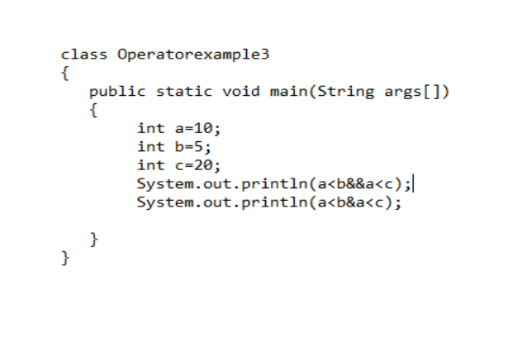
Examples of Operators (Cont.…)
S

Slide 25
Examples of Operators (Cont.…)
S
Output:
❖false
❖false

Slide 26
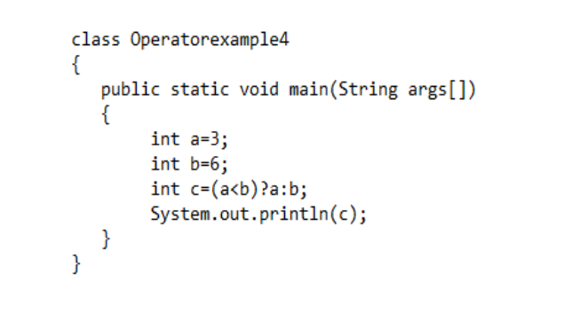
Examples of Operators (Cont.…)
S

Slide 27
Examples of Operators (Cont.…)
S
Output:
❖3

Slide 28
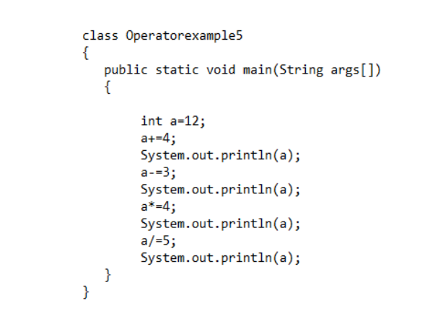
Examples of Operators (Cont.…)
S

Slide 29
Examples of Operators (Cont.…)
S
Output:
❖16
❖13
❖52
❖10

Slide 30
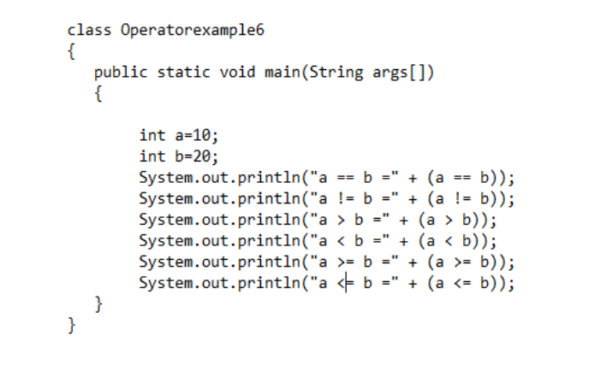
Examples of Operators (Cont.…)
S

Slide 31
Examples of Operators (Cont.…)
S
Output:
❖a == b = false
❖a != b =true
❖a > b =false
❖a < b =true
❖a >= b =false
❖a <= b =true

Slide 32
Thank You ?

